Slide 1
Nepal GEA SOA ESB Design Guidelines
School of Management, Tribhuvan University
Date: 11th May 2023

Slide 2
Introducing Teams
Pooja Singh
Prabesh Adhikari
Prashreeti Wasti
Sandhya K.C.

Slide 3
Abbreviation
GEA → Government Enterprise Architecture
SOA → Service Oriented Architecture
ESB → Enterprise Service Bus

Slide 4
Service Design Principles
Represents a design approach comprised of eight specific design principles.
Service contracts adhere to most but not all of these design principles.

Slide 5
Eight Principles
Standard Service Contract
Service Loose Coupling
Service Abstraction
Service Reusability
Service Autonomy
Service Statelessness
Service Discoverability
Service Compos Ability

Slide 6
Standard Service Contract
Services within same service inventory
Compliance with the same contract design standards

Slide 7
Service Loose Coupling
Service contracts impose low consumer coupling requirements
Themselves decoupled from surrounding environment
Common types of coupling
Contract to Functional Coupling
Contract to Implementation Coupling
Contract to Logic Coupling
Contract to Technology Coupling
Logic to Contract Coupling

Slide 8
Service Abstraction
Service contracts contain only essential information
Information about services is limited to what is published in service contracts
Turning services into black boxes, make contracts available to consumer officially
Principle is about hiding of information by service owners

Slide 9
Service Reusability
Service contracts contain and express agnostic logic and can be positioned as reusable enterprise resource
Principle focuses on ensuring service logic is robust and generic; qualities also carry over into contract design

Slide 10
Service Autonomy
Service contracts states that services exercise a high level of control over their underlying runtime execution environment

Slide 11
Service Statelessness
Service contracts states that services minimize resources consumption by deferring the management of statement information when necessary

Slide 12
Service Discoverability
Service contracts states that services are supplemented with communicative mega data by which they can be effectively discovered and interpreted
Primary focused on attempting to make each service as discoverable and interpretable by range of project team members

Slide 13
Service Compos Ability
Service contracts states that services are effective composition participants, regardless of the size and complementary of the composition
Concerned with ensuring the service contracts are designed to represent and enable service to be effective composition participants

Slide 14
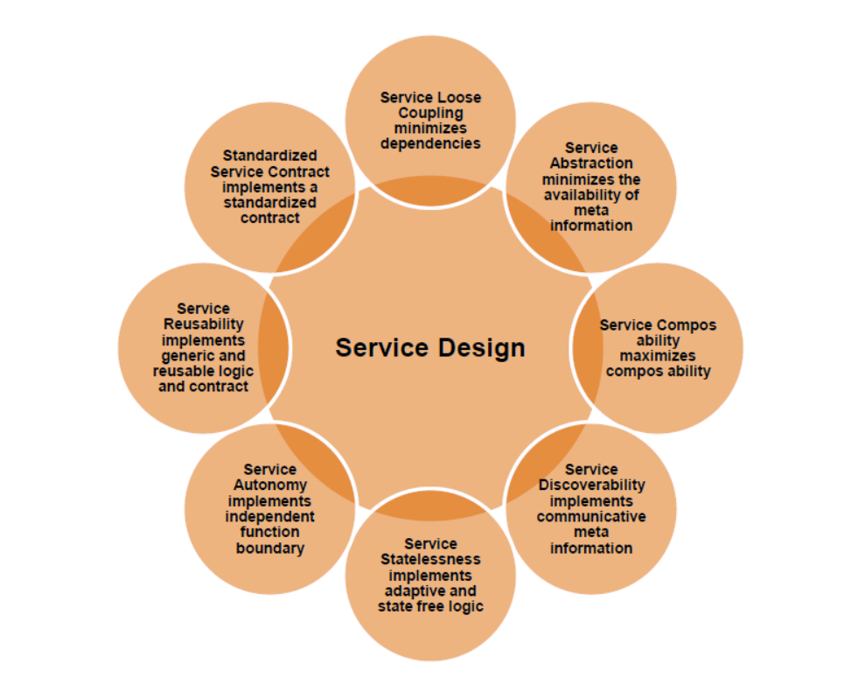

Slide 15
Service Design Pattern
Service Design Patterns provide a proven solution to a common problem in context, individually documented in a consistent format.
As with design principles, the following design patterns can be applied to various measures.

Slide 16
As with design principles, the following design patterns can be applied to various measures.
Service Inventory Design
Service Design Patterns
Service Composition Design Patterns

Slide 17
Service Inventory Design
Service inventory represents a collection of independently standardized and governed services
Foundational Inventory Patterns
Logical Inventory Layer Patterns
Inventory Implementation Patterns

Slide 18
a. Foundational Inventory Patterns
Provides the baseline design characteristics of service inventory
Enterprise Inventory → how services can be delivered to maximize re-composition
Service Normalization → how service inventory can avoid redundant service logic
Service Layers → how in an inventory be organized based on functional commonality
Canonical Schema → how services can be designed to avoid data model transformation

Slide 19
b. Logical Inventory Layer Patterns
Address how services within a service inventory can be grouped into logical layers
Entity Abstraction → how agnostic business logic can be sepatarated, reused and governed independently
Process Abstraction → how non-agnostic logic can be separated and governed independently

Slide 20
c. Inventory Implementation Patterns
Address a variety of implementation design issues and option for service inventory
Canonical Resources → how unnecessary infrastructure resource disparity can be avoided
State Repository → how service state data can be persisted for extended periods without consuming service runtime resource

Slide 21
Service Design Patterns
Service design patterns specifically address the design of web services
Foundational Service Patterns → establish fundamental service design
Service Implementation Patterns → provide design for solutions
Service Security Patterns → shape the internal logic of services
Legacy Encapsulation Patterns → address interacting with legacy systems
Service Governance Patterns → address common governance issuses

Slide 22
Service Composition Design Pattern
Service composition design patterns address service of composition design and run time
Service Messaging Patterns → address inter-service message exchange
Transformation Patterns → how services interoperate using different data models for same type of data

Slide 23
THANK YOU!!

